Slide 1
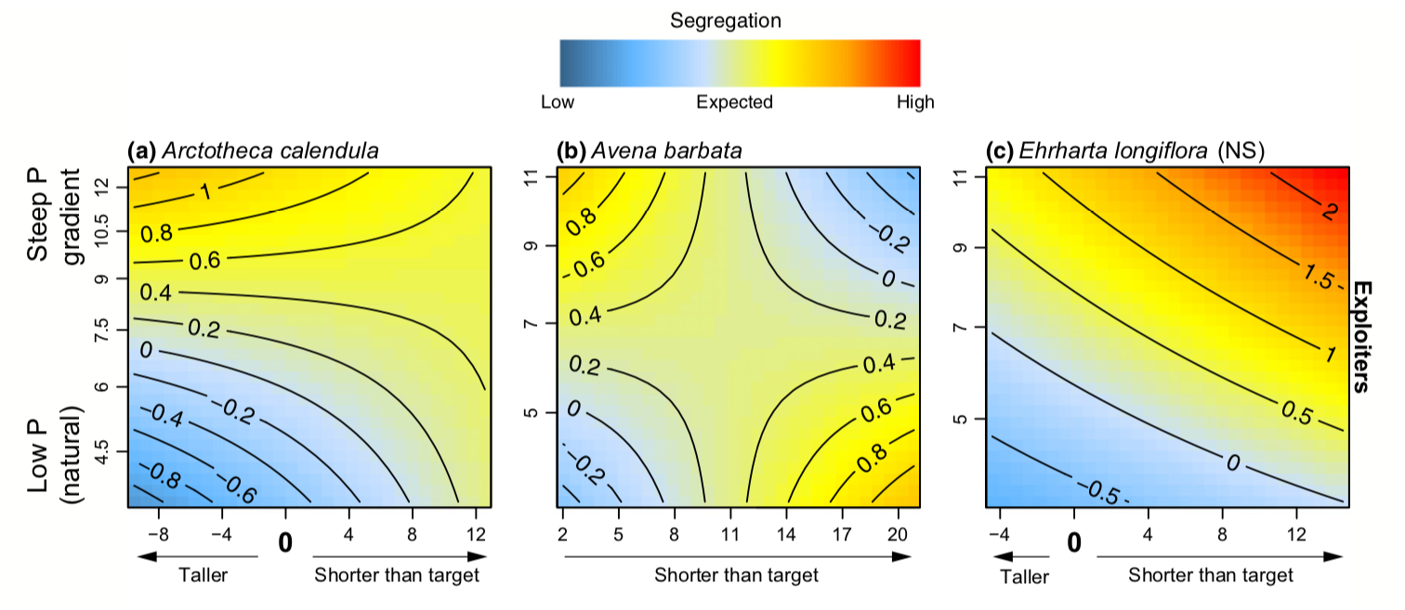
Data visualisation
Dr John Dwyer CONS7008

Slide 2
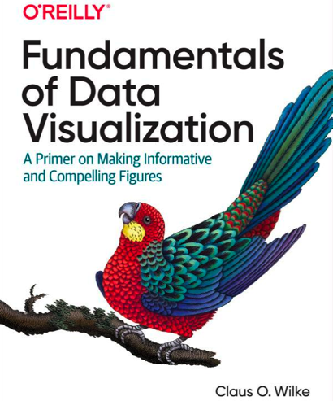
Fundamentals of Data Visualisation
“Data visualization is part art and part science. The challenge is to get the art right without getting the science wrong and vice versa. A data visualization first and foremost has to be correct. It must not mislead about or distort the data. If one number is twice as large as another, but in the visualization they look to be about the same, then the visualization is wrong.”
https://serialmentor.com/dataviz/

Slide 3
Major considerations
What aspect(s) of the data do you want highlight?
What is the main message?
What are the important comparisons?

Slide 4
Major considerations
Check out the Directory of visualizations in Ch. 5 of Fundamentals of Data Visualization

Slide 5
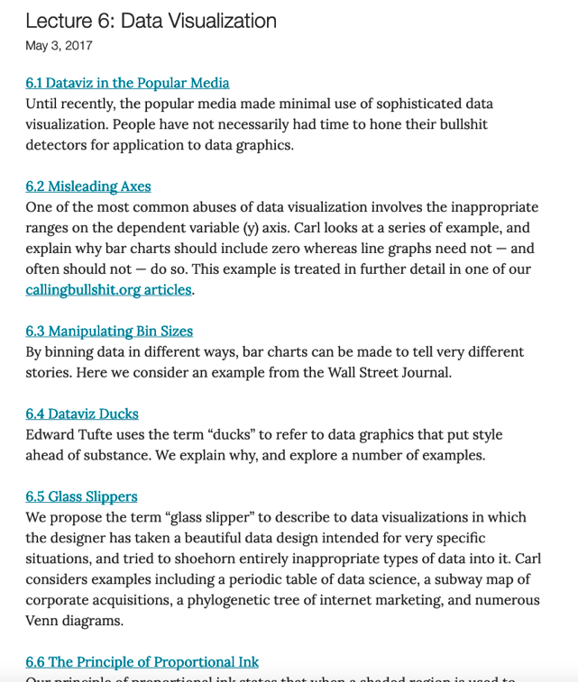
Calling bullshit!!!
https://callingbullshit.org/videos.html

Slide 6
Principle of proportional ink!
When a shaded region is used to represent a numerical value, the area of that shaded region should be directly proportional to the corresponding value.
Bergstrom & West 2016 (Calling Bullshit!)

Slide 7
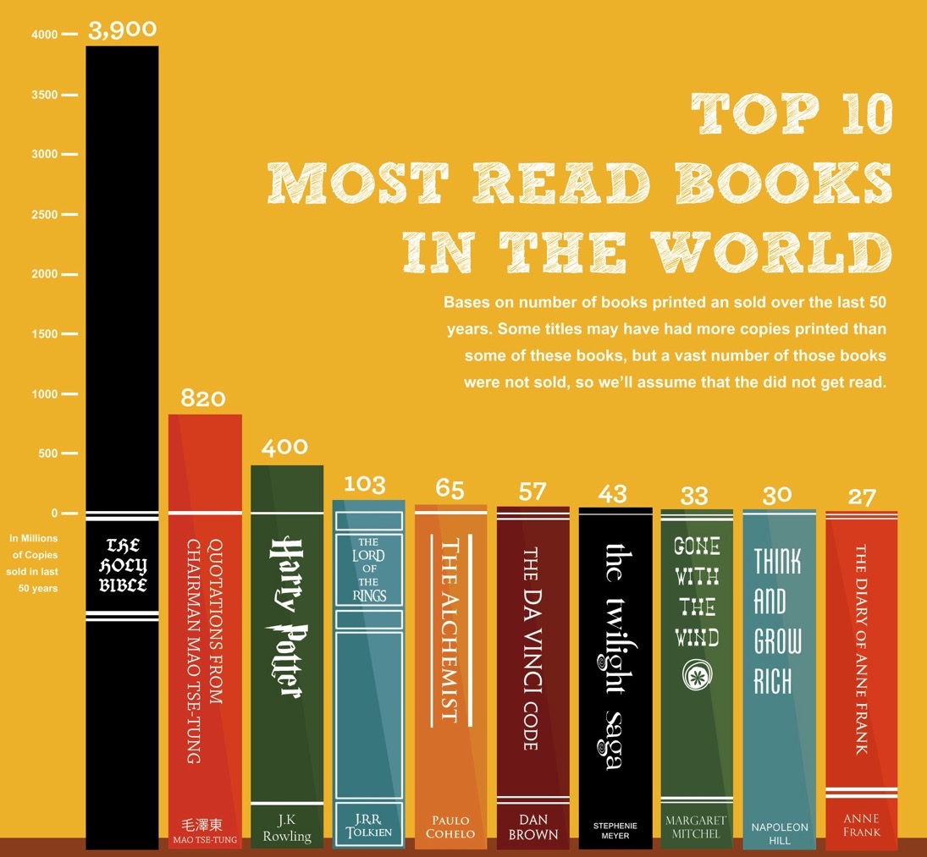
Business insider 2017

Slide 8
Basic bar charts…so many options!!!

Slide 9
Example:
Summary of seabird surveys in the Great Barrier Reef from 2010-2017

Slide 10
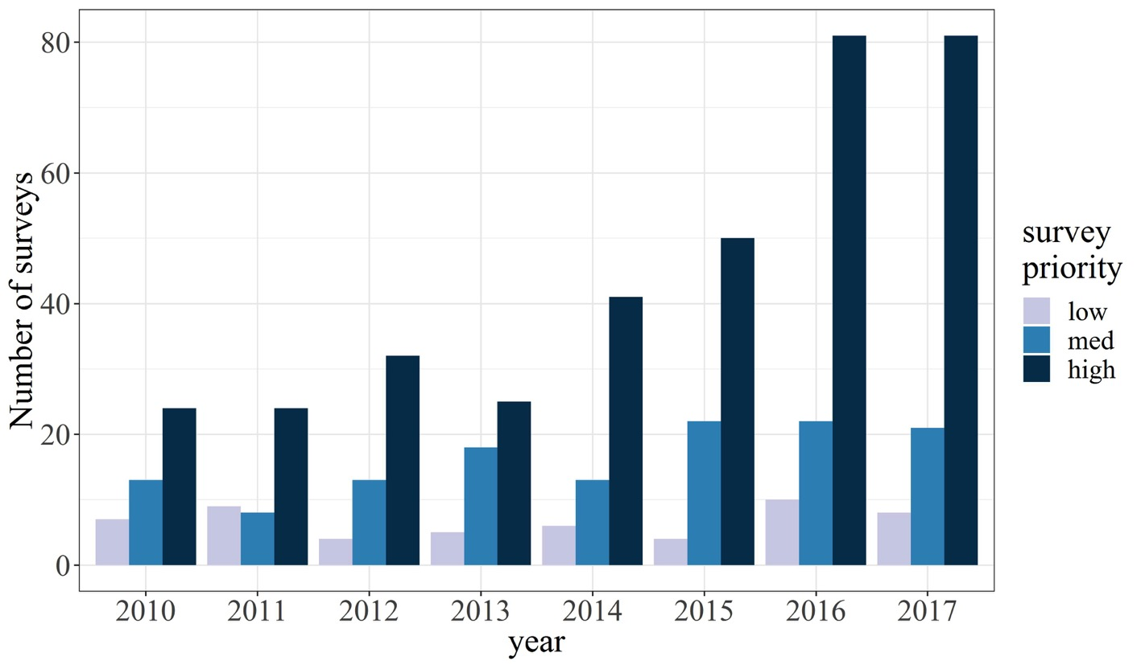

Slide 11
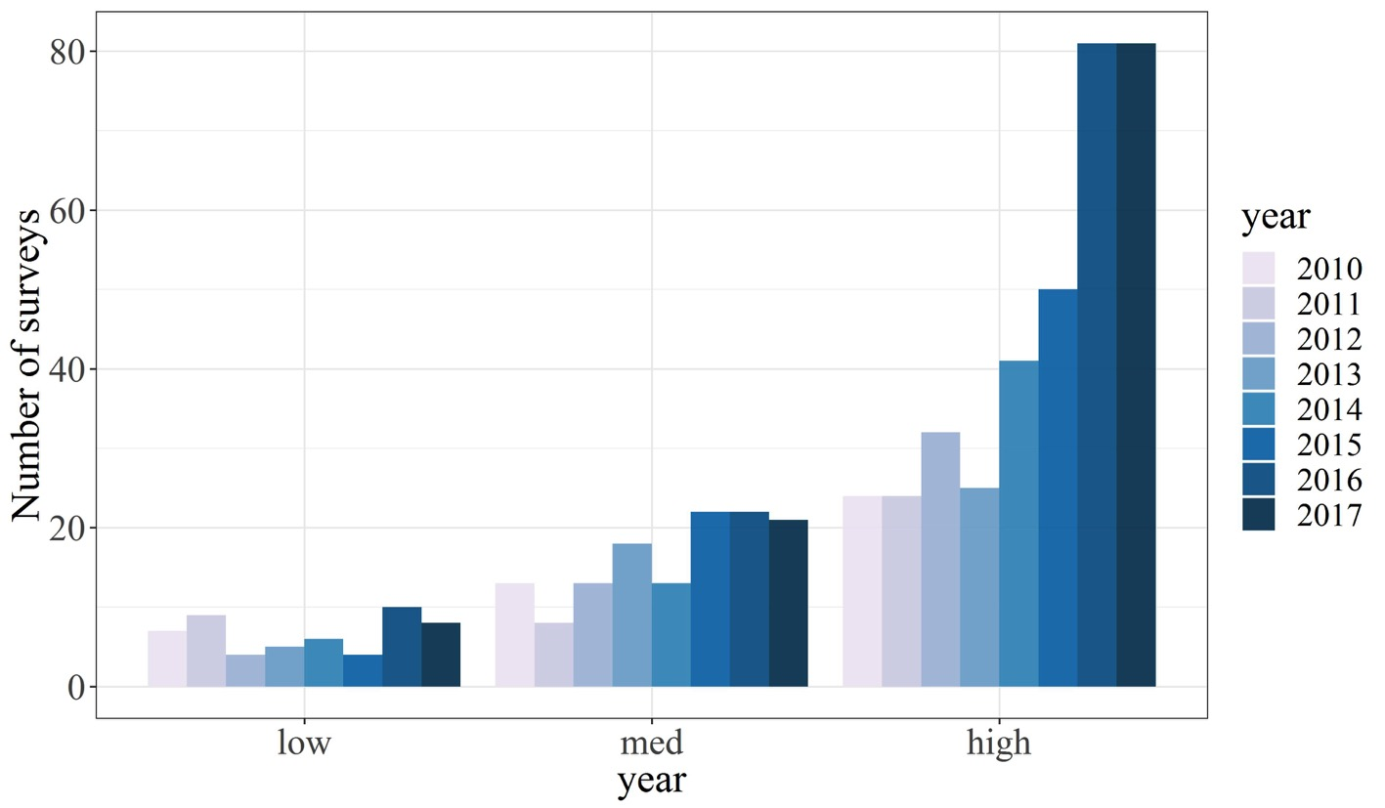

Slide 12
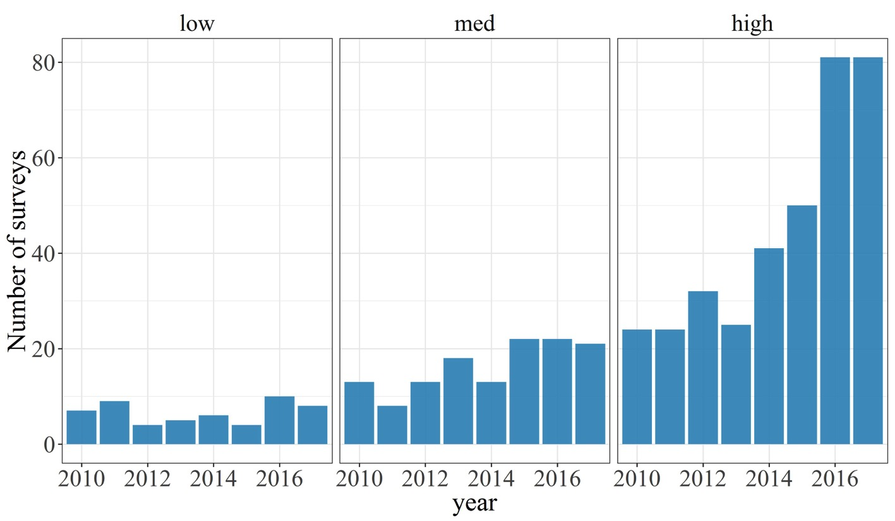

Slide 13
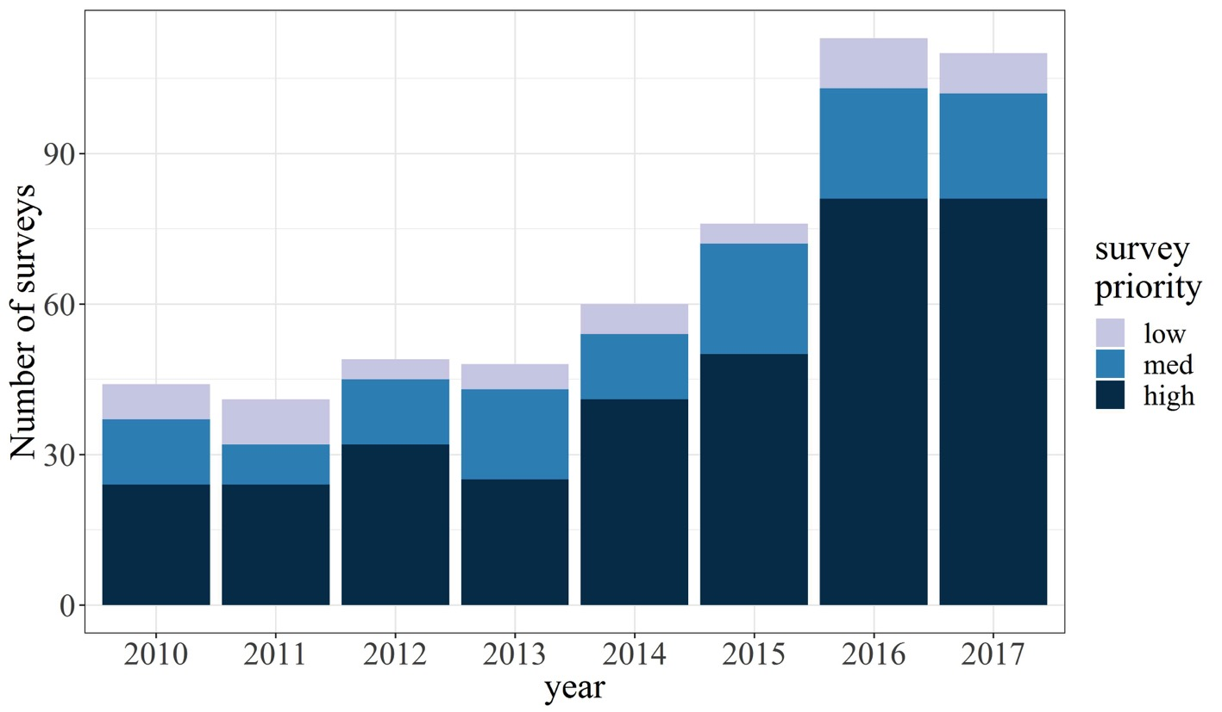

Slide 14





Slide 15
And now a word from our sponsor…

Slide 16

Not just statistics!
Data handling, manipulation, and wrangling
Data visualizations: exploratory and publication-quality
Tools to facilitate reproducible workflow
R projects, scripts, version control, markdown
Spatial tools (GIS)

Slide 17






Diverse, supportive user community
#rstats

Slide 18
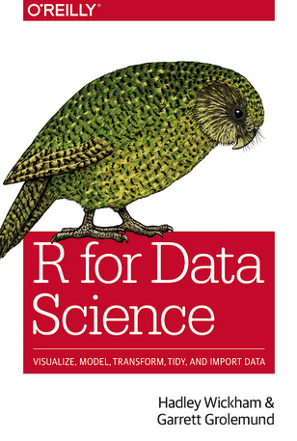
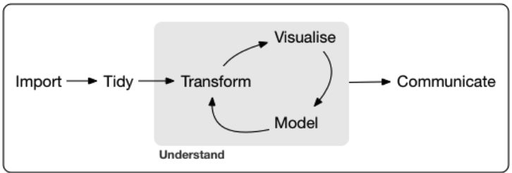
Amazing free resources!
Freely available at: r4ds.had.co.nz

Slide 19
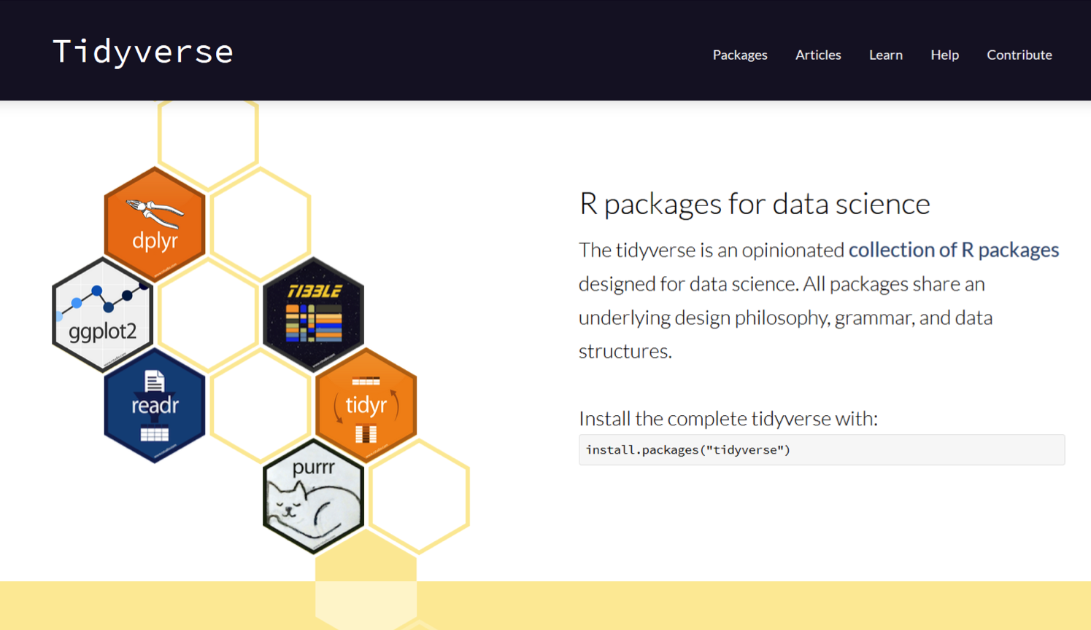

Slide 20
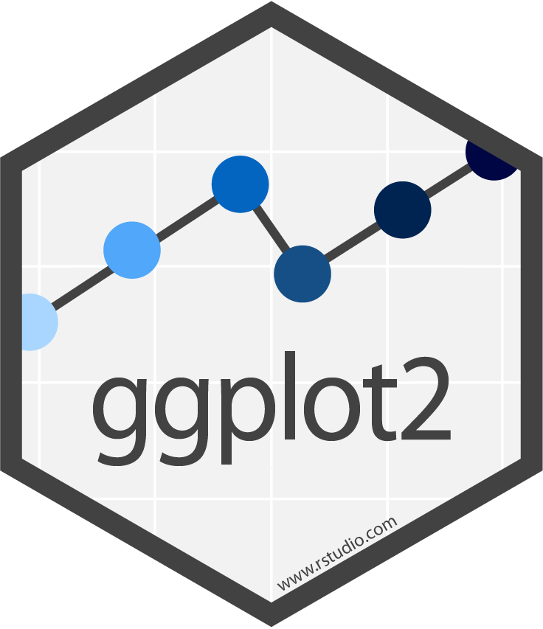
“R has several systems for making graphs, but ggplot2 is one of the most elegant and most versatile. ggplot2 implements the grammar of graphics, a coherent system for describing and building graphs. With ggplot2, you can do more faster by learning one system and applying it in many places.” – R4DS

Slide 21
ggplot2 example…tree growth!!!

Slide 22
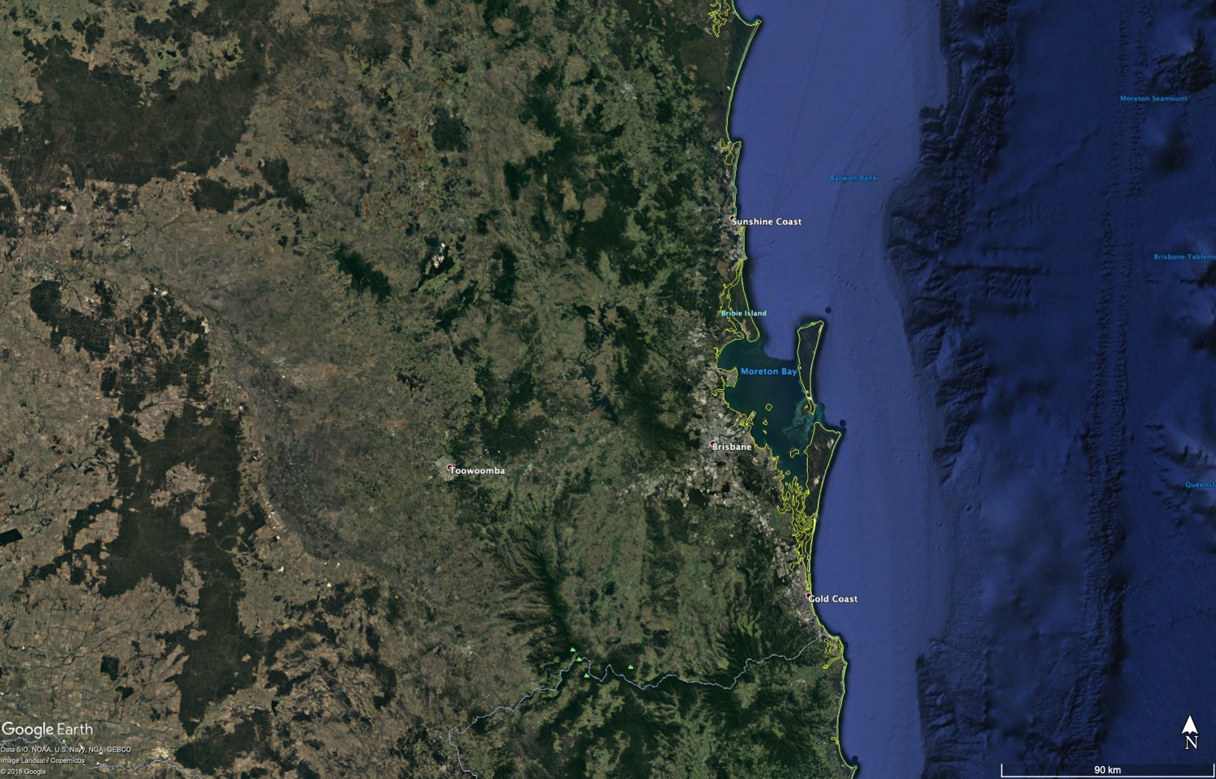

Slide 23
Bunya Mountains

Slide 24
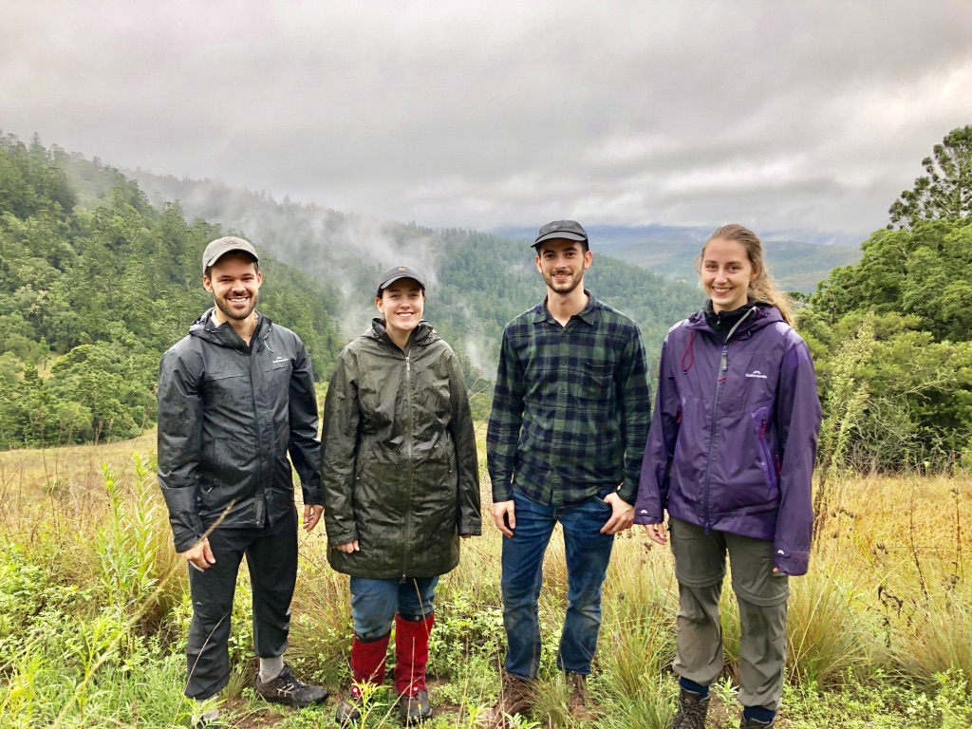

Slide 25
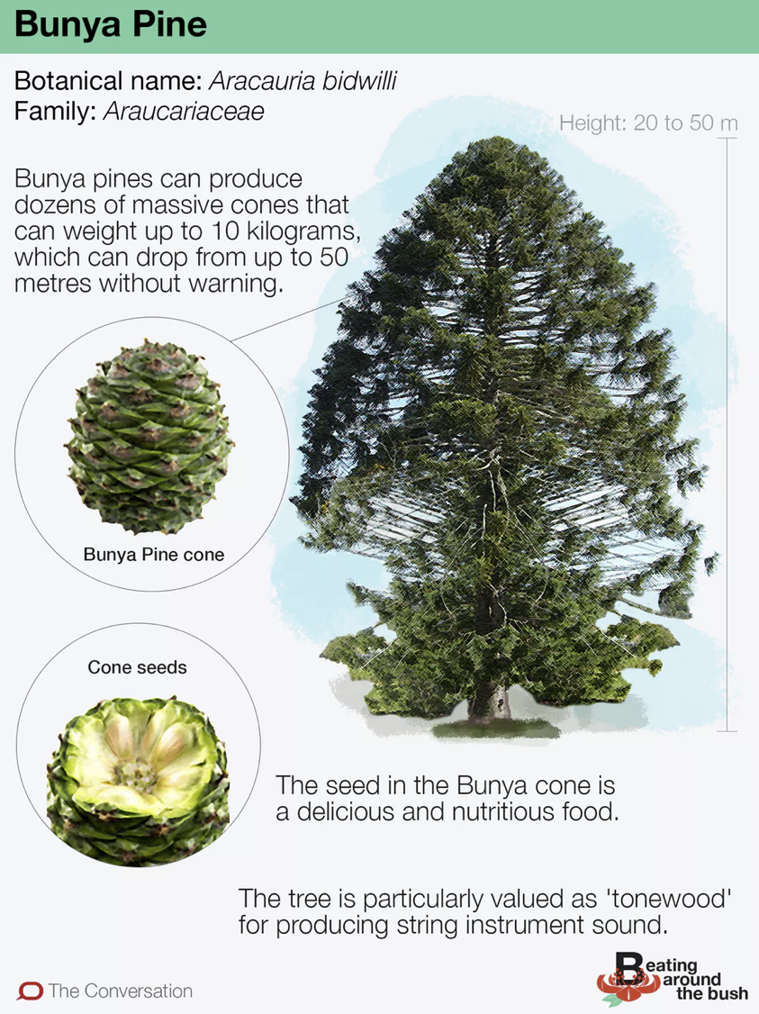

Slide 26
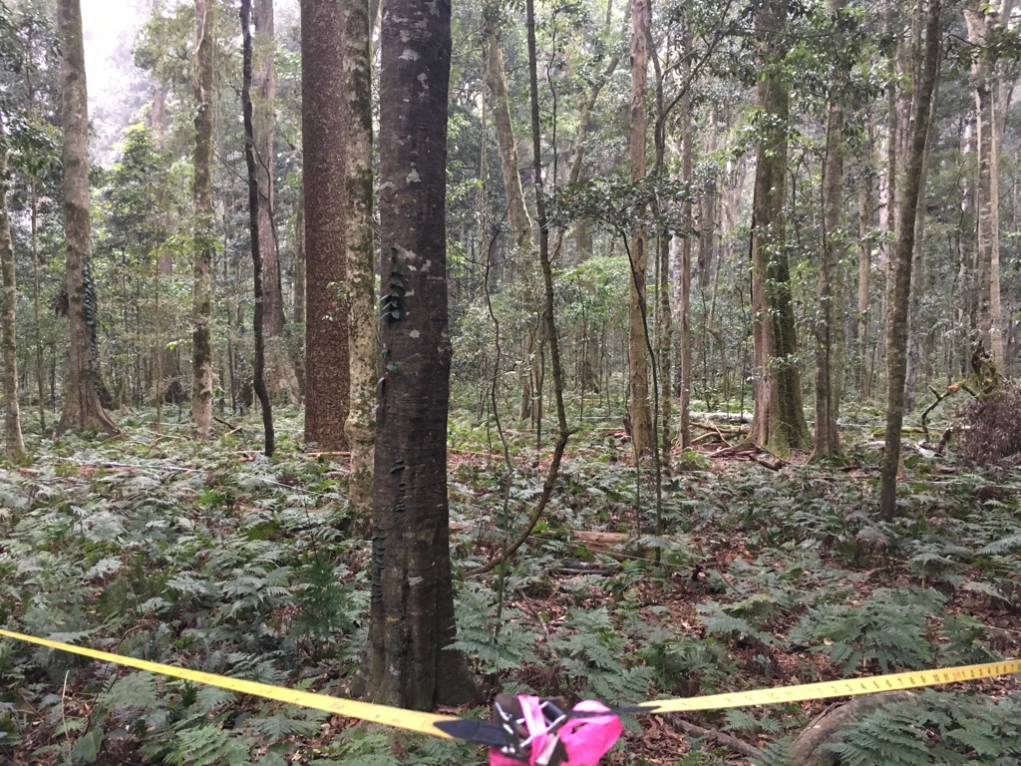

Slide 27
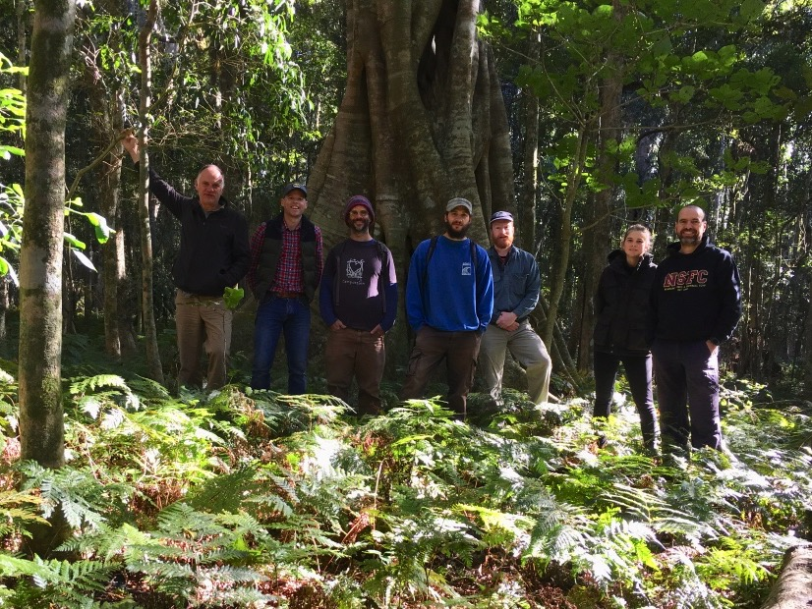

Slide 28
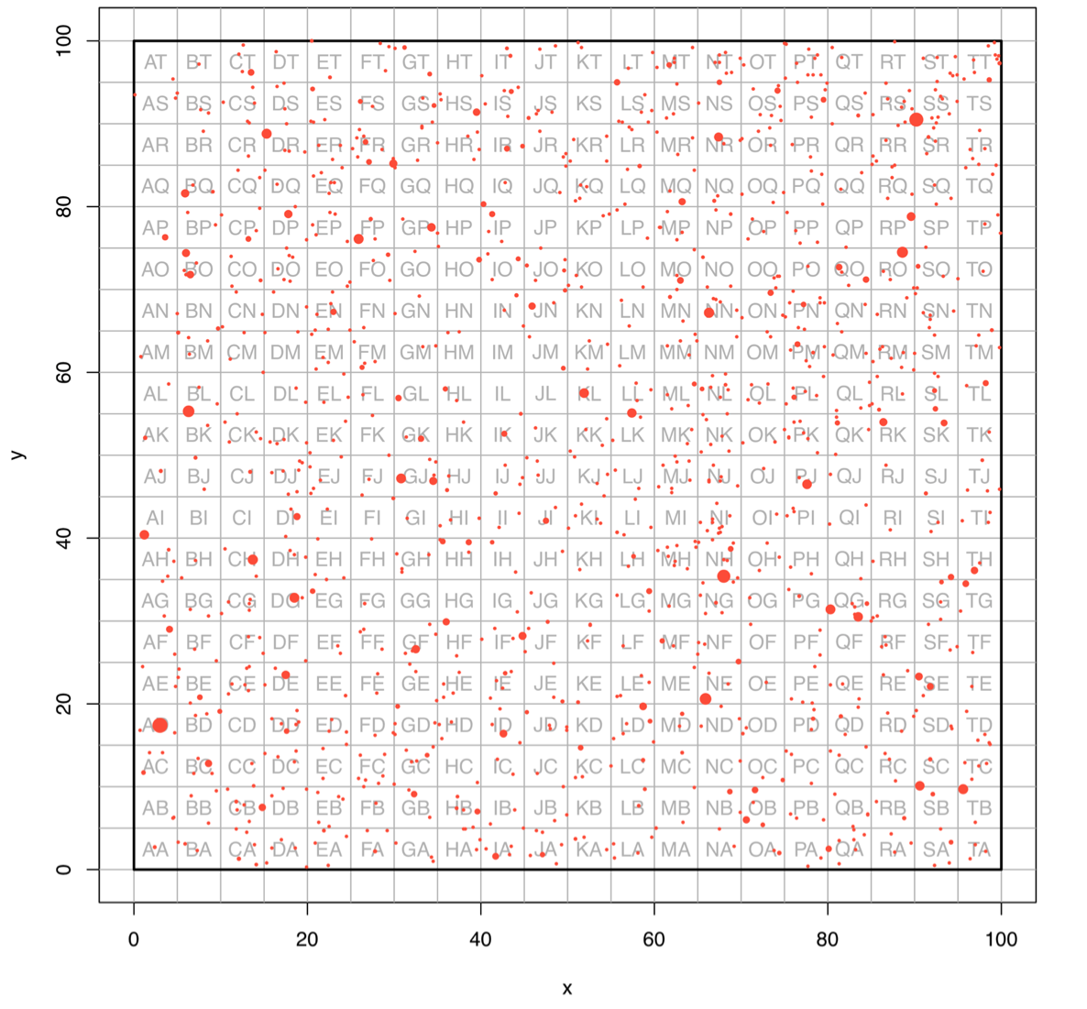

Slide 29
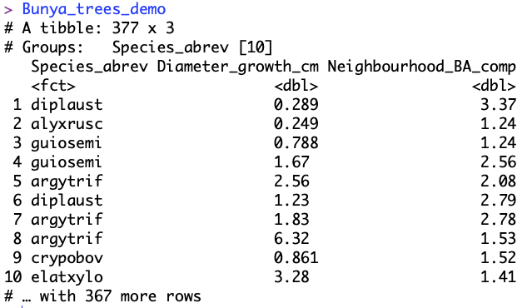

Slide 30
How do tree species vary in their diameter growth increments over a 17 year period?

Slide 32
Why might this be a poor datavis option for these data?

Slide 33
Can we do better than this???

Slide 34
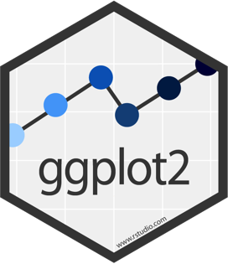
## Bunya Mountains Trees Example
starting_plot<-ggplot(data = Bunya_trees_demo,
aes(x=Species_abrev, y = Diameter_growth_cm))

Slide 35
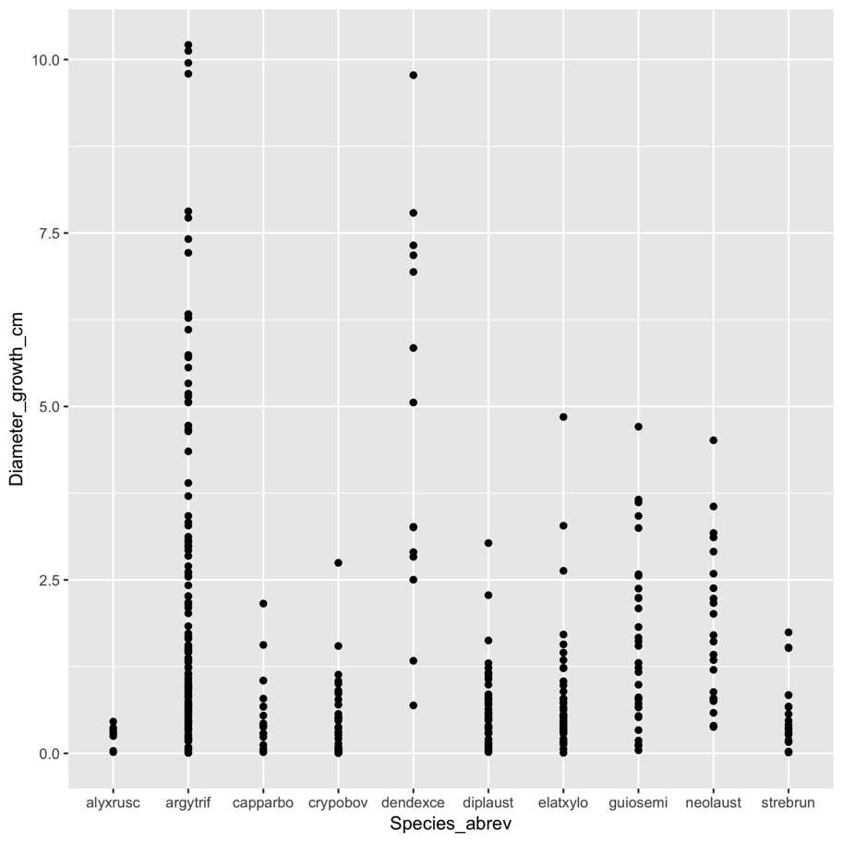
## Bunya Mountains Trees Example
starting_plot + geom_point()

Slide 36
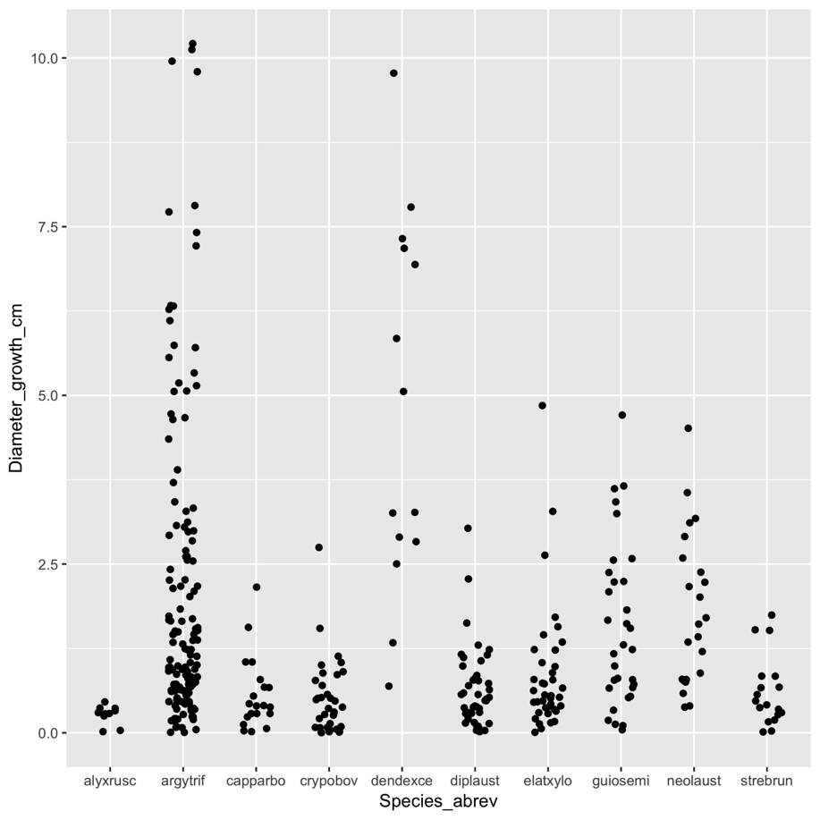
## Bunya Mountains Trees Example
starting_plot + geom_jitter(position=position_jitter(0.2))

Slide 37
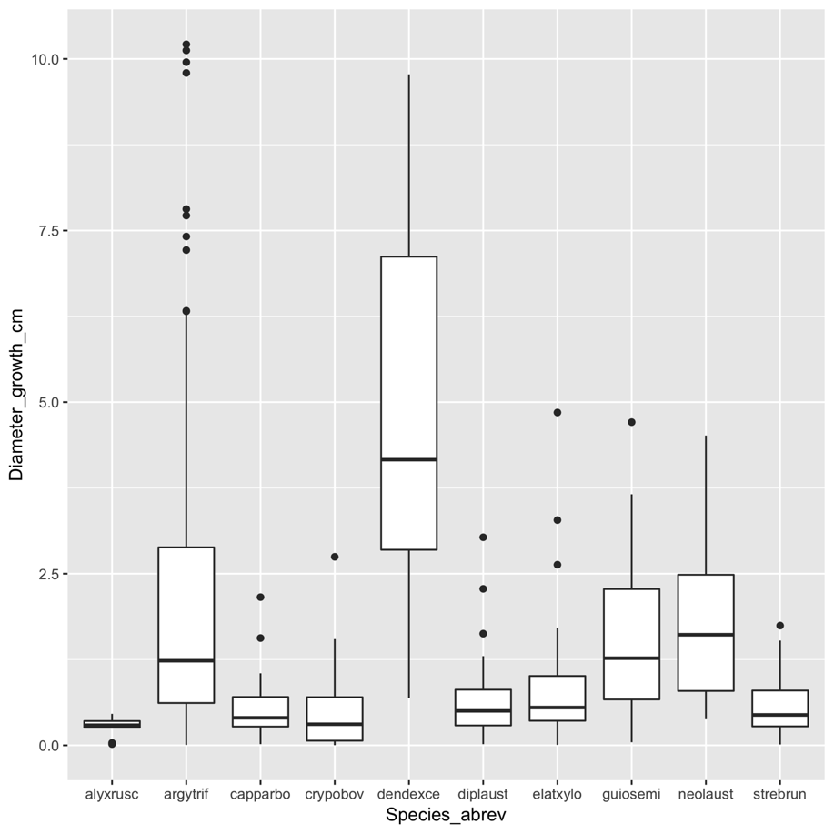
## Bunya Mountains Trees Example
starting_plot + geom_boxplot()

Slide 38
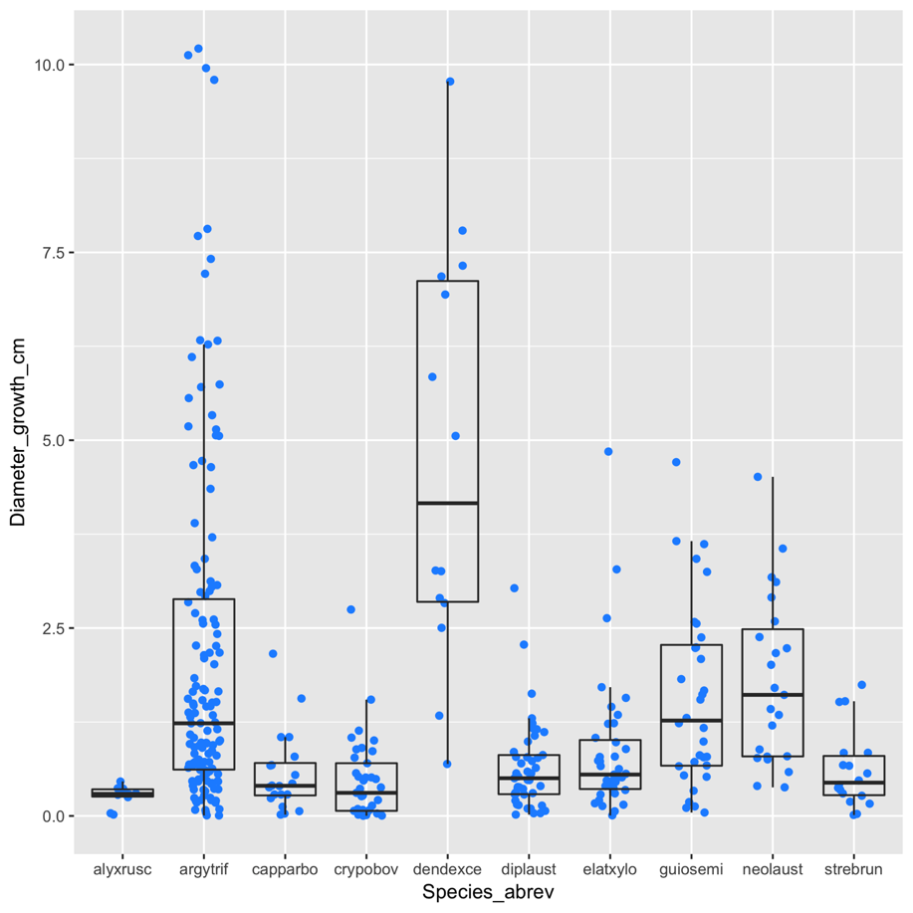
## Bunya Mountains Trees Example
starting_plot + geom_jitter(position = position_jitter(0.2), colour = "dodgerblue") + geom_boxplot(fill = NA, outlier.shape = NA)

Slide 39


Slide 40

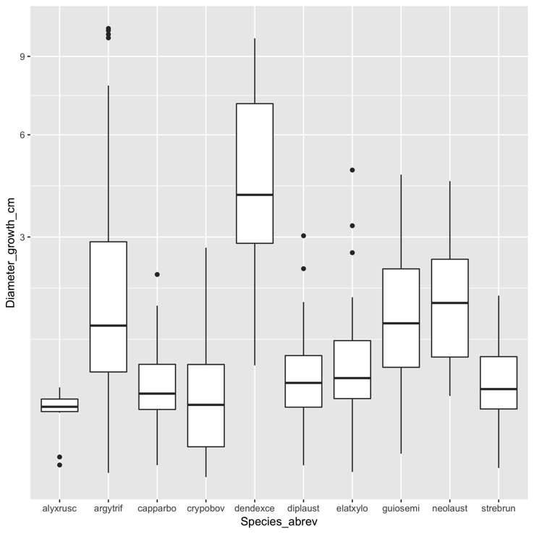
## Bunya Mountains Trees Example
starting_plot + geom_boxplot() + scale_y_sqrt()

Slide 41
Is a tree’s growth related to the biomass of other trees in its immediate neighbourhood?

Slide 42
## Bunya Mountains Trees Example
starting_plot2<-ggplot(data = Bunya_trees_demo,
aes(x=Neighbourhood_BA_comp,
y = Diameter_growth_cm))

Slide 43
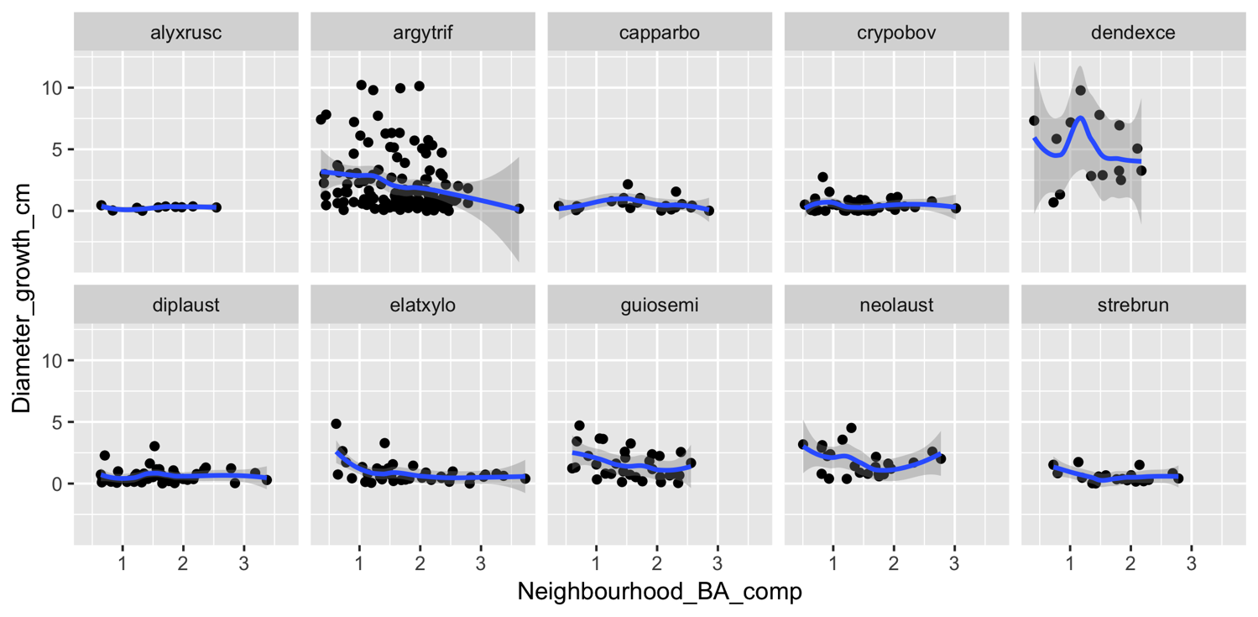
## Bunya Mountains Trees Example
starting_plot2 + geom_point() + geom_smooth() + facet_wrap(~ Species_abrev, ncol = 5)

Slide 44
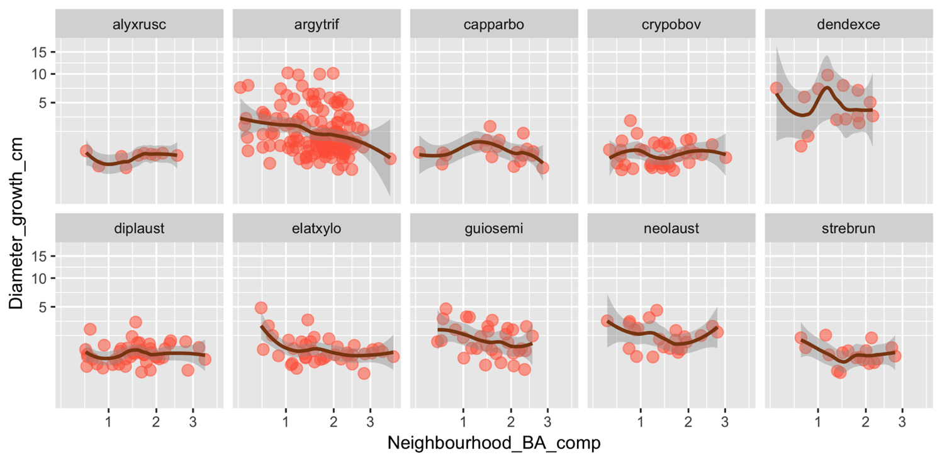
## Bunya Mountains Trees Example
starting_plot2 + geom_point(colour = 'tomato',
alpha = 0.5, size = 3) +
geom_smooth(colour='saddlebrown') +
scale_y_sqrt() + scale_x_sqrt() +
facet_wrap(~ Species_abrev, ncol = 5)

Slide 45
MANY other options:
https://ggplot2.tidyverse.org/reference/index.html
http://www.ggplot2-exts.org/

Slide 46

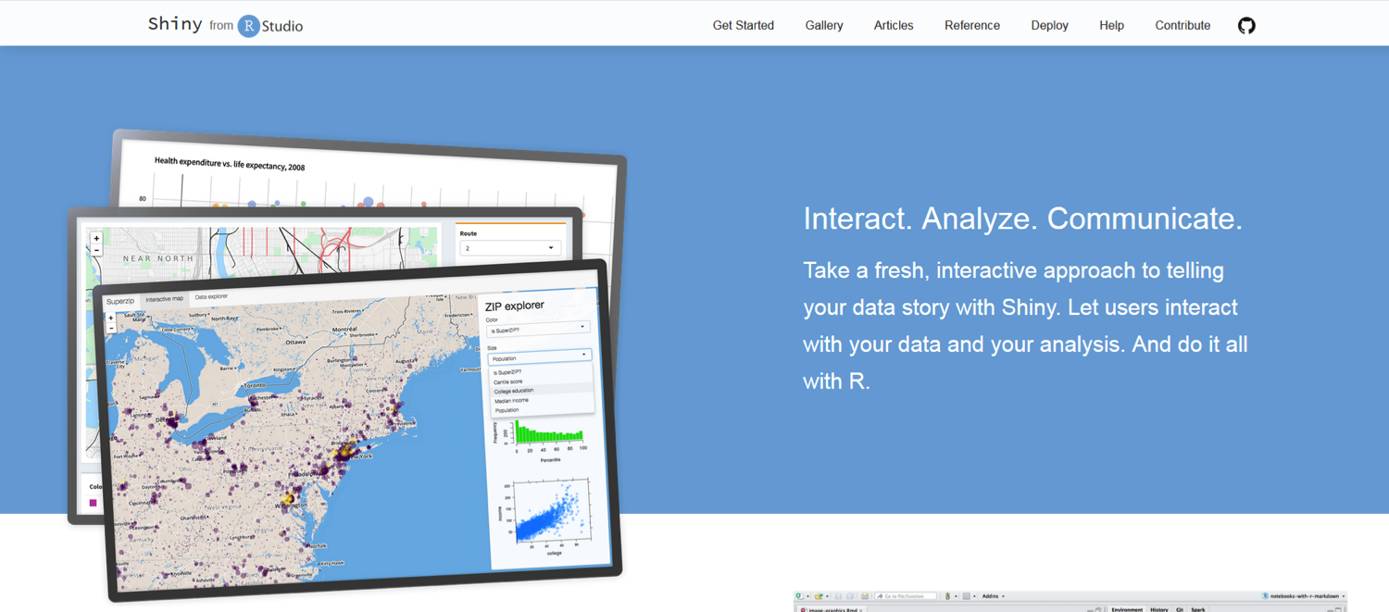
https://shiny.rstudio.com/

Slide 47
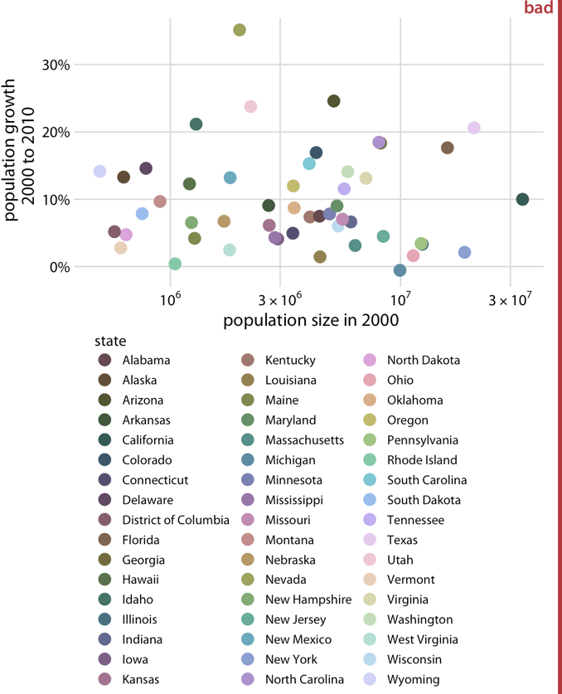
Colour (go easy…tiger!!!)
Use it, but…
be consistent
avoid redundancy
choose nice ones!
Fundamentals of Data Visualization (https://serialmentor.com/dataviz/)

Slide 48
Key points
Show us the raw data if possible
Don’t assume a particular distribution (e.g. normal) when plotting data
The figures should match the nature of associated analyses
Use colour ONLY TO GOOD EFFECT!!!

